Slide 1

DEVELOPMENT OF A PERSONAL VIRTUAL ASSISTANT FOR WINDOWS
GUIDED BY
DR.R.PALSON KENNEDY,
B.E ,M.E ,PH.D
PRINCIPAL
SUBMITTED BY
ARCHANA B - 411521104007
LAKSHMI PRIYA M - 411521104059

Slide 2
ABSTRACTION
Nexus is a Windows-based virtual assistant inspired by Cortana and Siri. Designed for seamless user interaction, it executes tasks via voice commands or keyboard input. The assistant integrates speech recognition, natural language understanding, and task execution to enhance efficiency. Built entirely in Python, it advances human-computer interaction by providing an intuitive and intelligent desktop assistant, streamlining everyday computing for improved productivity and convenience.

Slide 3
METHODOLOGY
Follows an iterative approach for development.
Proceeds with design and prototyping of UI and conversation flow.
Core development includes Natural Language Processing (NLP) and
Machine Learning (ML).
Integrates with Windows APIs.
Uses Agile methodologies like Scrum or Kanban.
Begins with requirement gathering and analysis.
Emphasizes continuous testing and refinement.

Slide 4
DATA COLLECTION
Gathers data such as:
Text-based interactions
Voice commands
User behavior
Contextual information
Sources include:
User input
Existing datasets
Windows APIs (calendar, contacts, file system)
Methods:
Manual annotation
Automated tools
Crowdsourcing
Ensures data quality, accuracy, relevance, and privacy.

Slide 5
CALCULATIONS
1. Development Cost Breakdown
Design (UI/UX): Wireframes, mockups, prototyping
Frontend Development: Desktop GUI or web-based interface
Backend Development: NLP integration, Windows API usage, ML model setup
AI/ML Services: Training, model hosting (Cloud services)
Integration: Windows features like file access, reminders, calendar
2. Tool & Platform Costs
Subscription/licenses for tools like:
Microsoft Bot Framework (if paid tier)
Dialogflow
IBM Watson
Cloud services (Google Cloud, Azure, AWS): Compute, storage, APIs
3. Testing and QA
Manual and automated testing tools
Bug fixing cycles
Usability testing

Slide 6
PROJECT PROGRESS
Phases Completed
Requirement Gathering & Analysis
System Design & Architecture
User Interface Design
Backend Logic & Core Features Development
Integration with Windows API
Initial NLP Functionality (Command Recognition)
Currently in Progress
Advanced NLP Features (Contextual Understanding)
Testing & Debugging
Report Documentation
Upcoming Tasks
Final Testing and QA
Deployment & Demo Preparation

Slide 7
MODELS/FRAMEWORKS USED
Microsoft Bot Framework
Google Dialogflow
IBM Watson Assistant
Google Cloud AI Platform
Provide:
Conversational interface tools
NLP capabilities
Machine learning support

Slide 8
FUTURE WORK
Smarter Language Understanding Assistants will better understand and respond to natural human speech.
Better System Integration They’ll work smoothly with more apps, devices, and platforms.
More Task Automation They’ll handle repetitive tasks, saving time and effort.
AR/VR Compatibility Assistants will support immersive virtual and augmented reality experiences.
Personalized Experience They’ll learn user preferences for tailored interactions.
Smart Device Control Voice control across homes, cars, and wearables will become seamless.
Continuous Learning They’ll become smarter over time by learning from user behavior.

Slide 9
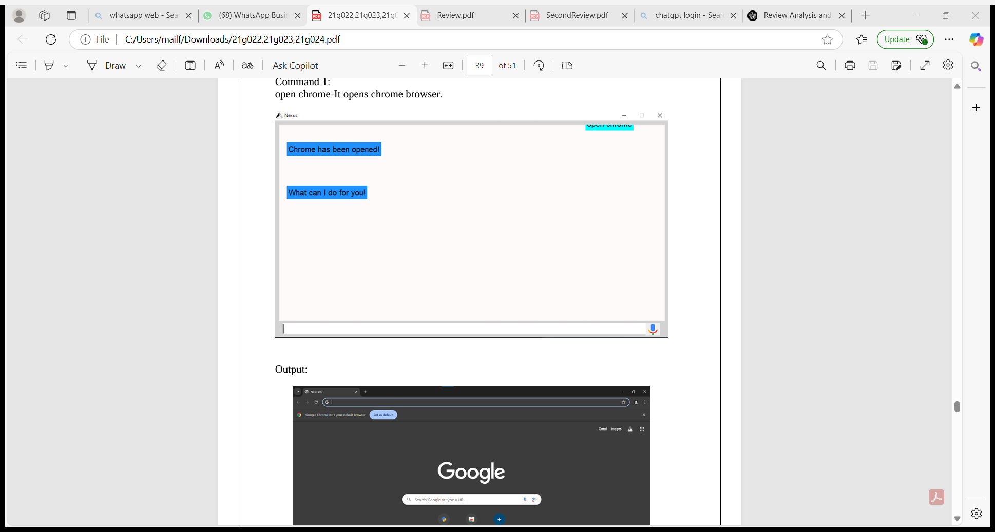
SNAPSHOTS
Command Execution
Command : Open Chrome-it Opens Chrome Browser.

Slide 10
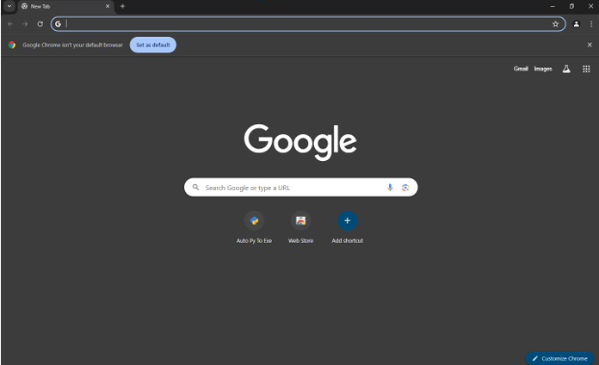
SNAPSHOTS
OUTPUT :

